Slide 1
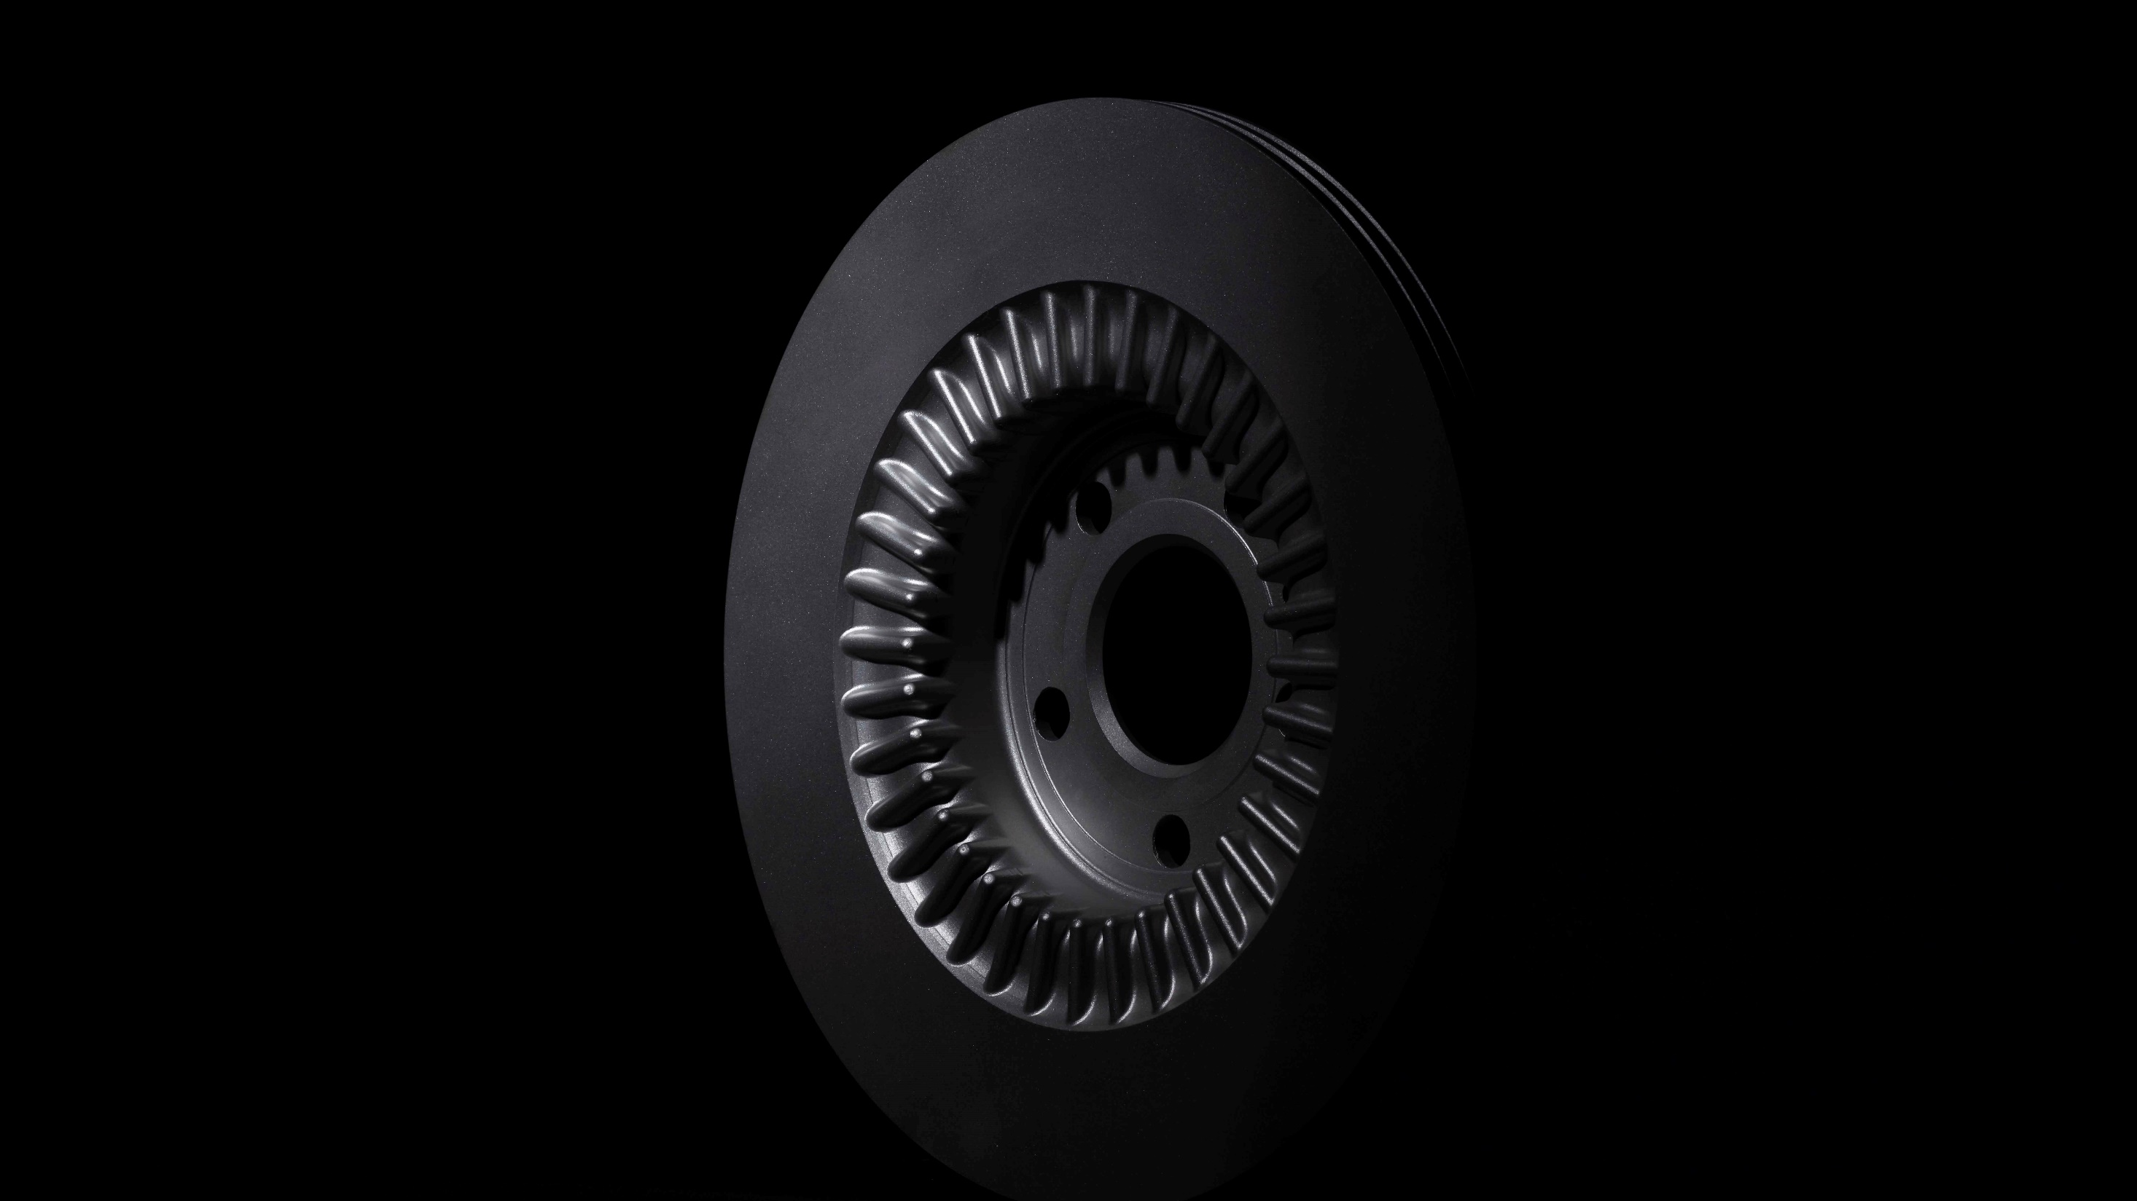

Slide 2
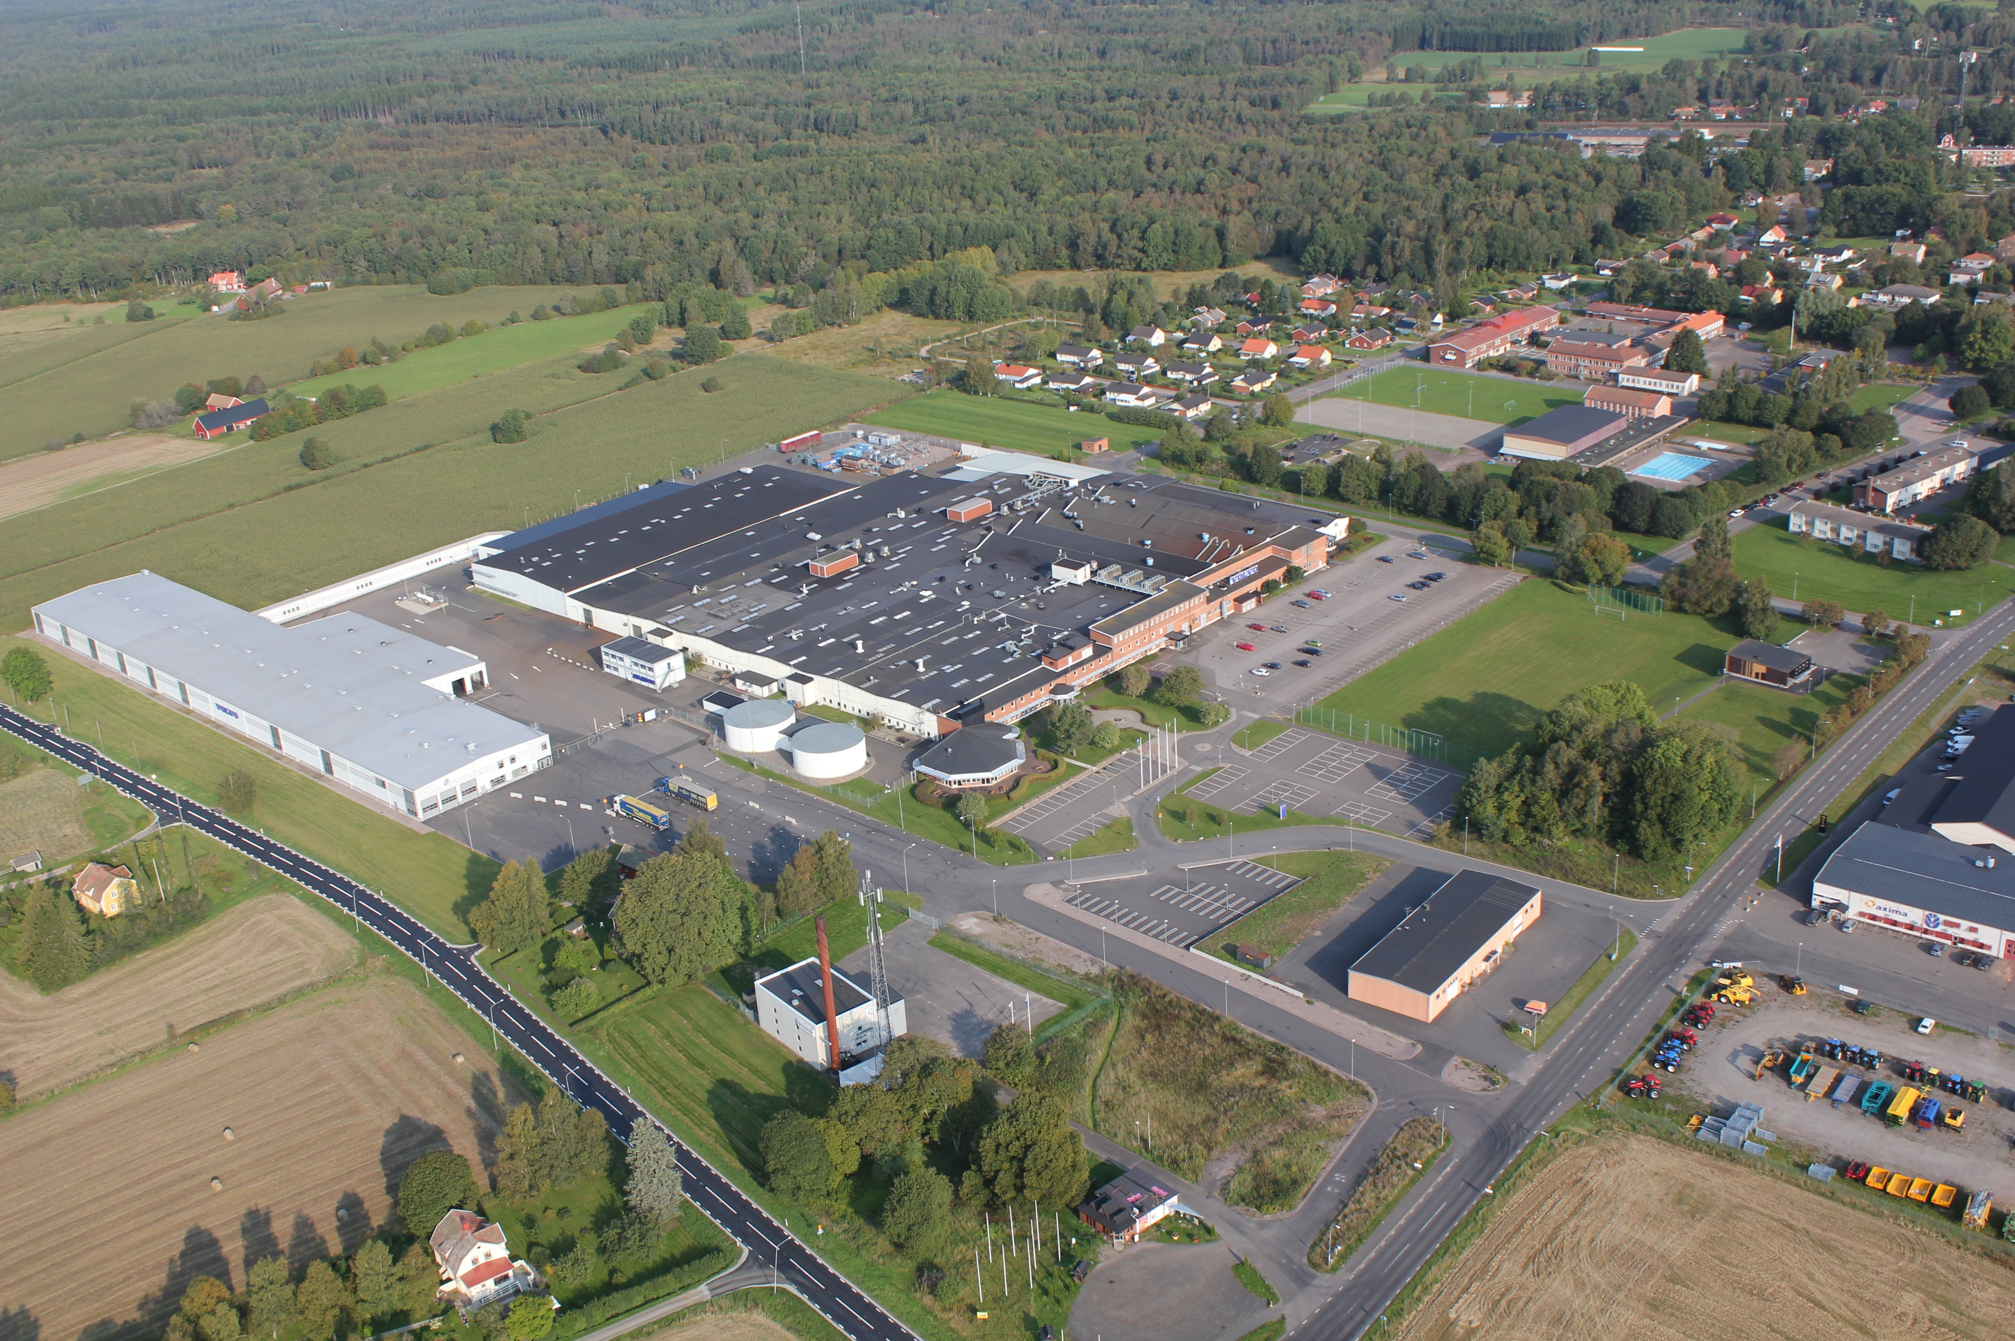
Notes:
Mission - Apply its technology and know-how to manufacture and sell first-class components to the automotive market
Vision - The vision is to produce world-class automotive supplies produced with joy and pride

Slide 3
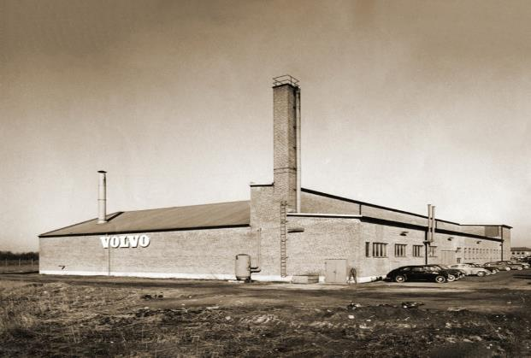
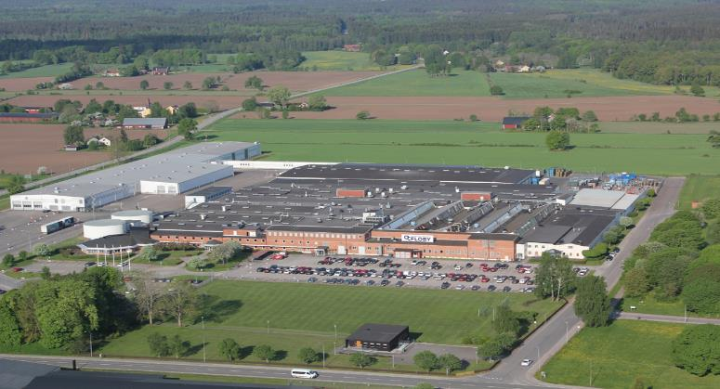
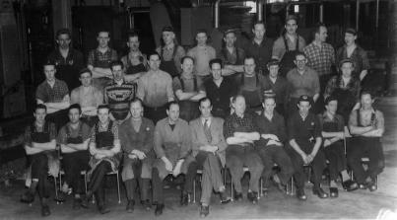
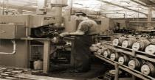
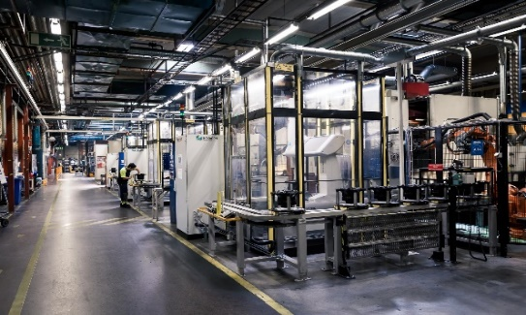
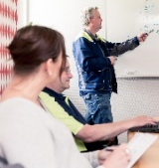
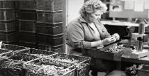
Stolt arv – Stark framtid
Sedan starten 1957 har AC Floby tillverkat flera typer av mycket avancerade och kvalitativa komponenter för fordonsindustrin.
AC Floby är helägt av Volvo Cars Group men agerar som en oberoende leverantör
Fabriksyta: 39 000 Kvadratmeter
Anställda: 440
Omsättning 2021: 2 057 604 000 SEK
Notes:
1957 = 1 600 m2 plant
Since its founding in 1957, AC Floby has manufactured several types of highly advanced and qualitative components for the automotive industry.
Today 2018 – 39 000 m2 plant
As one of Falköping's largest employers, we are a safe workplace. Our business means a lot for the region and we work closely with the society and the local business and school community.
Antal anställda 2018-03-17= 536 st.
Mer exakt: 195 981 635 EUR i omsättning.

Slide 4
Current product offering
Wheel hubs
Brake discs
Connecting rods
Complete module
SiCAlight & GCI solid/ventilated
Straight & angled

Slide 5
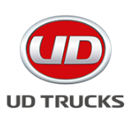
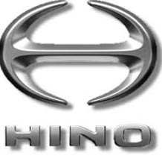
We are proud to supply premium Products
AC Floby is targeting customers asking for a premium supplier with
…and request products with
Global full service support
Latest technology
Top delivery precision
Top quality performance
Machining with top class tolerance level
Automated handling to optimize costs
Relevant price level
Integrated and flexible production process flow
Notes:
World wide customer base
Very well connected logistically at only 1.5 hours northeast of the international harbor of Gothenburg.
-By cooperation with companies in the European market, we are also a part of the industrial network in Sweden and the world. The factory location with good infrastructure close to the port of Gothenburg allows us to offer competitive and sustainable solutions our customers around the world.
Deliveries are made to all “corners” of the Globe.
Deliveries are spread among customers in the Automotive and Commercial vehicles OEM and Tier1.

Slide 6
Rollfördelningar
Yrken – Teknisk gymnasieutbildning
Produktion, Operatör Montör
Produktionsresurser
Stödfuktioner
Företagsfunktioner
Produktion:
Operatör, Montör
Produktionsresurser:
Teknik/Kvalitetsstöd.
Stödfunktioner:
Mätrum, Underhåll, Maskinister. Logistiktekniker.
Företagsfunktioner:
Finans, Inköp, Sälj, HR mm
Kompetensutveckling
Interna/ Externa Företagsutbildningar
YH utbildningar
Högskolan i Skövde / WISER

Slide 7
Översikt Roller
75

Slide 8
Pågående jobbrekryteringar
www.nyposition.se

Slide 9
